Slide 1

Data Programming
Final Project
Submission by:
Harsh Rajnikant Patel - 200490490
Rakshit Luke Wilson - 200489590
Submission To:
Prof. Ethan Davis
Professor, Georgian College

Slide 2
Introduction to the Project
We live in a world with an ascending rate of population, hence ascending chaos.
To keep the chaos from leading us to a bad direction, we as a team recognise our area of study, data analysis to be an asset for critically analysing the present to plan a better future.
Our Project works on a dataset taken from year 1952 -2007, of countries around the globe with respect to their population, year of survey and the country’s GDP to predict its current situation.
The project as as required makes use if 6 different charts to analyse the dataset.

Slide 3

Introduction to the Team
Member name : Harsh Rajnikant Patel
Team Role: Developer
Project Manager
Education: Bachelor's in Computer Engineering,
Post Graduate Certificate in Artificial
Intelligence Design, Analysis and Implementation
Skills: Problem solving
Good at development
Analysis skills
Languages: Python, JavaScript, C#

Slide 4

Introduction to the Team
Member Name: Rakshit Luke Wilson
Team role: Business Analyst
Data Analyst
Education: Bachelors in Computer Science and Engineering
Skills: Team Management
Business Research and processing strategies
Logical and Analytical skills
Languages: Java Script

Slide 5
Our Dataset
Our dataset works on 6 Variables namely, Country name, Year of Survey, Population of Country, Continent the country is located in, The life expectancy of the Country, and the country’s GDP rate in the specific year.

Slide 6
The Project
The project works on a jupyter computing platform.
We made use of the “pandas” Library. To make use of data analytical tools.
Pandas Library: Pandas is a software library written for the Python programming language for data manipulation and analysis. In particular, it offers data structures and operations for manipulating numerical tables and time series.

Slide 7
3. The project works on a sqlite Database to store the dataset and the analytical graph outputs.
4. The code can be accessed online through the link provided in the code format.
5. The use of plotly is considered in the project to make meaning and useful graphs to support the project ideas and concepts.

Slide 8
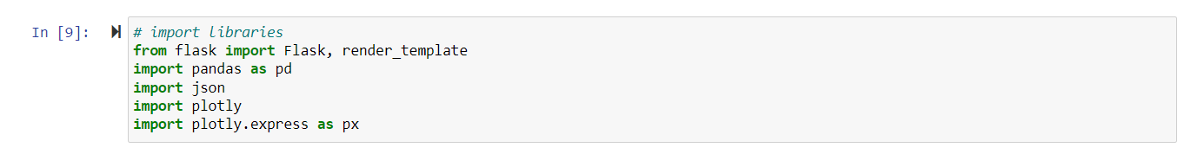
6. Use of Flask
Flask: Flask is a small and lightweight Python web framework that provides useful tools and features that make creating web applications in Python easier. It gives developers flexibility and is a more accessible framework for new developers since you can build a web application quickly using only a single Python file.

Slide 9
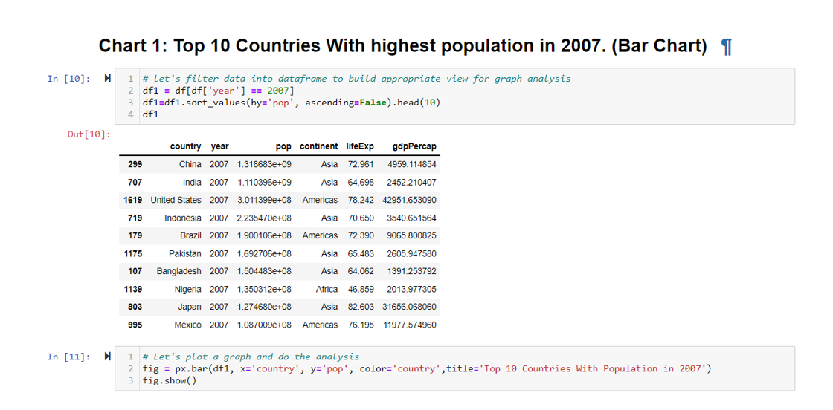
The project makes use of analytical tools to deploy 6 Charts.

Slide 10
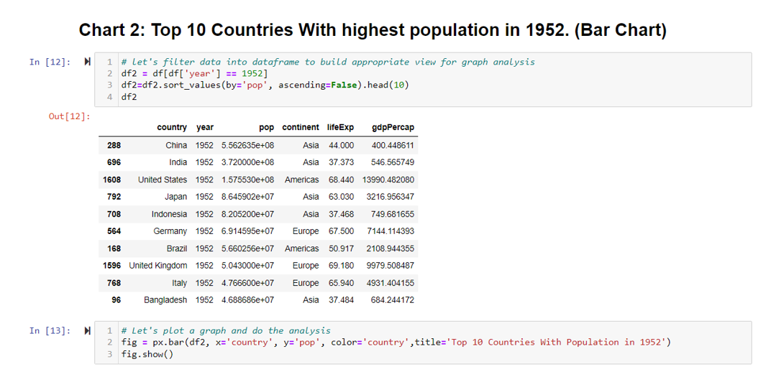
The project makes use of analytical tools to deploy 6 Charts.

Slide 11
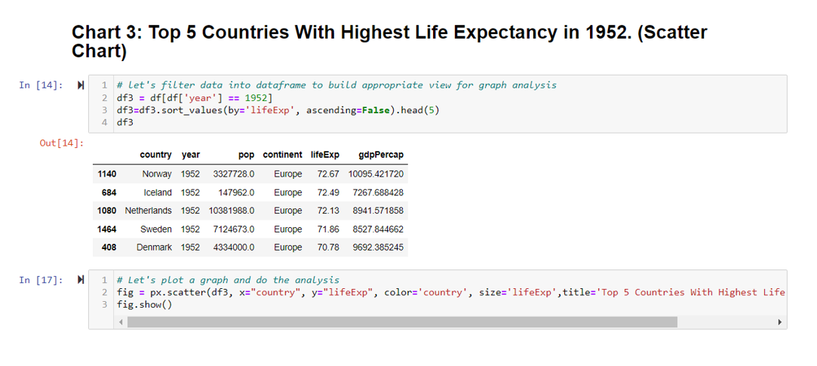
The project makes use of analytical tools to deploy 6 Charts.

Slide 12
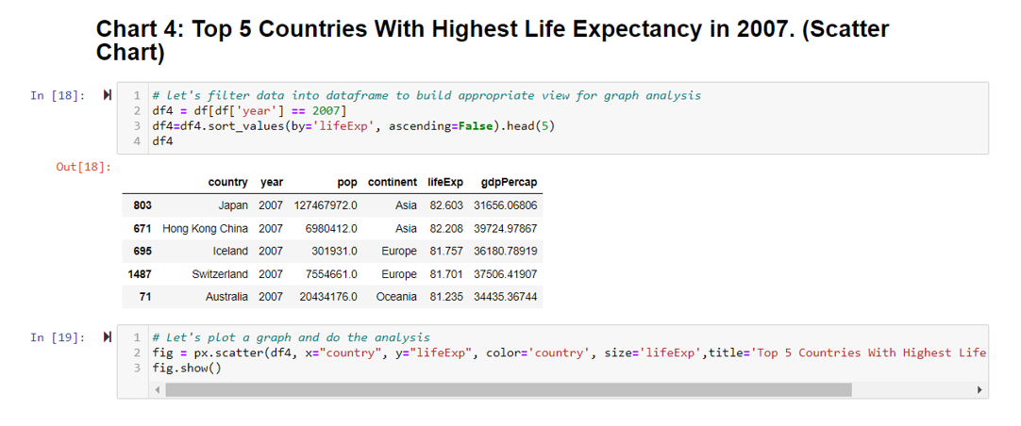
The project makes use of analytical tools to deploy 6 Charts.

Slide 13
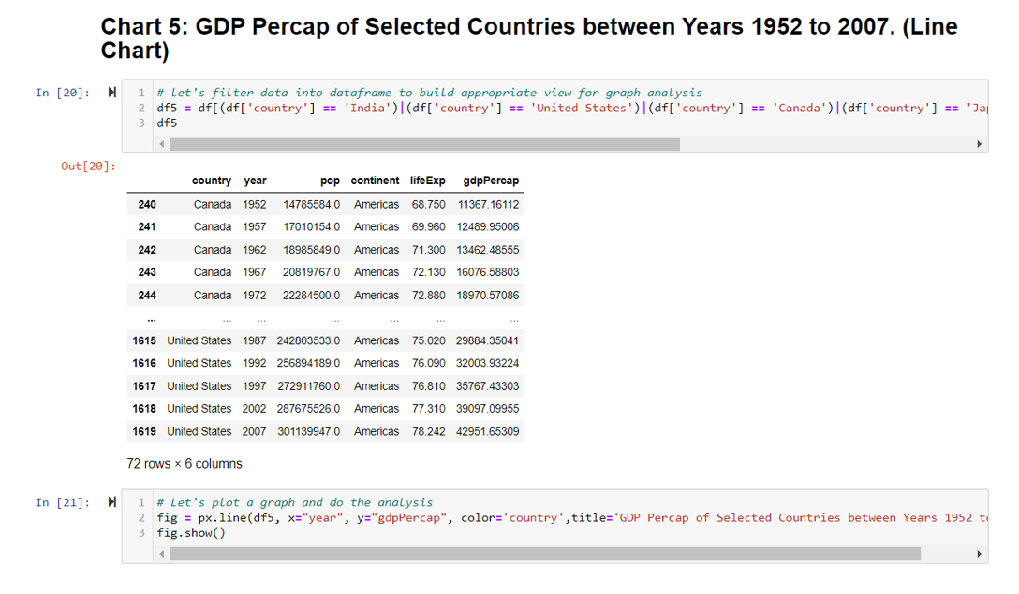
The project makes use of analytical tools to deploy 6 Charts.

Slide 14
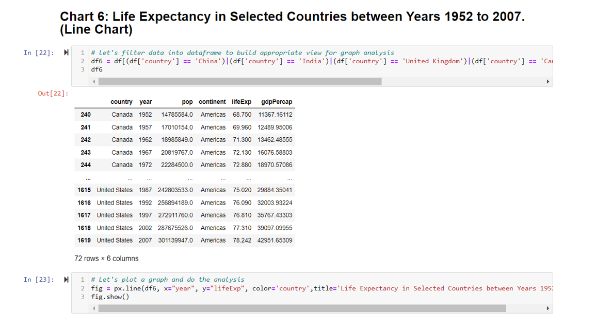
The project makes use of analytical tools to deploy 6 Charts.

Slide 15
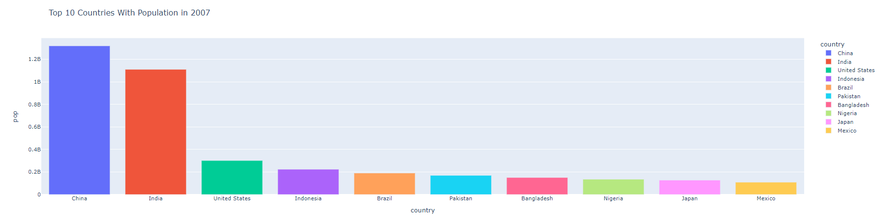
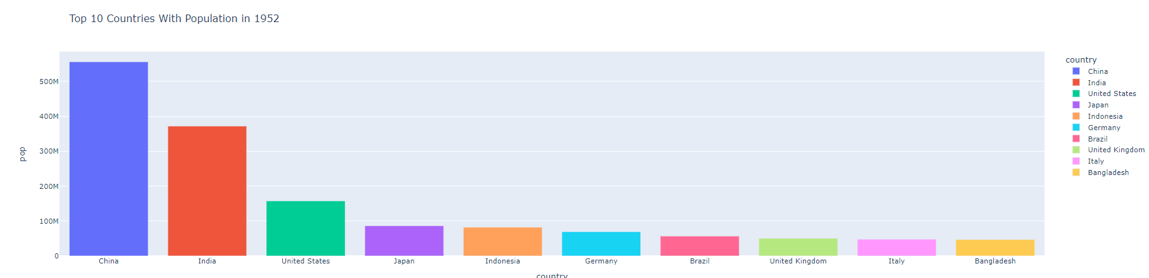
Output Charts

Slide 16
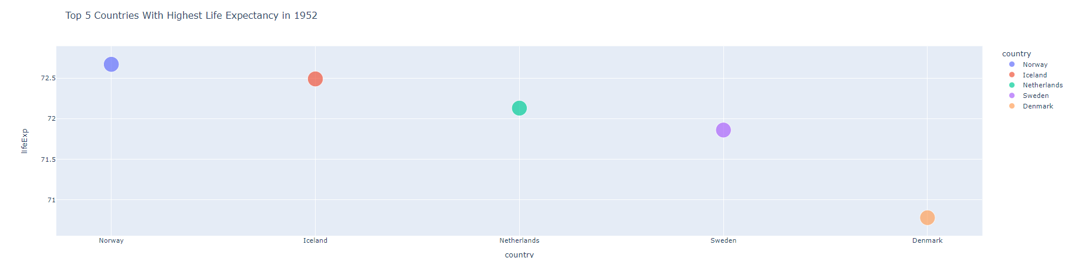
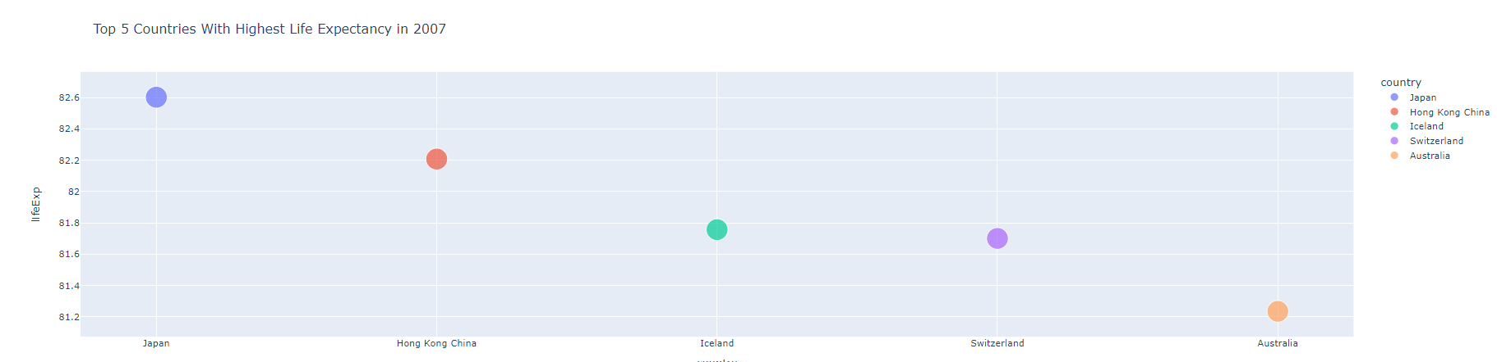
Output Charts

Slide 17
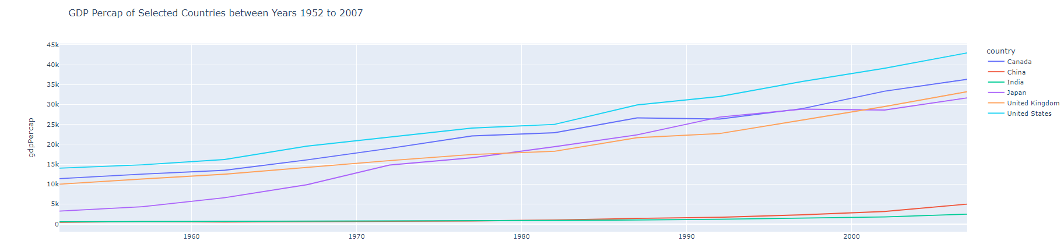
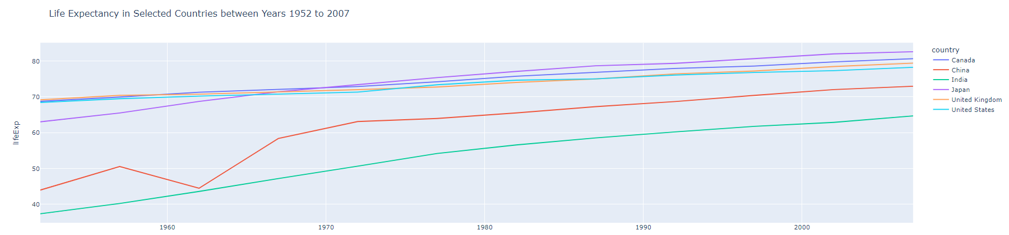
Output Charts

Slide 18
End of Presentation.

